Slide 1
An Analysis of the Relationships Between General and Primary Voter Turnout In U.S. Presidential Elections
Jemi Assefa, Sanita Gurung, Tom VanEyck

Slide 2
Summary
Questions: Does primary election turnout predict general election turnout?
How do certain characteristics such as # of eligible voters, # of registered voters, election type ( re-election vs new election) and # of voters by state have an impact on general elections?
Hypotheses : We believe the voter turnout of the general election will be impacted by these characteristics, but we believe primary turnout will have the most impact.

Slide 3

Data Source – US CENSUS DATA
Data – Links: Raw data was sourced from the United States Election project and the US Census Data website files
United States Election project http://www.electproject.org/home/voter-turnout/voter-turnout-data
US Census Data website files https://www.census.gov/topics/public-sector/voting/data/tables.html
1. 1980-2014 Turnout Rates,
2. 2000, 2004, 2008, 2012, 2016 Primary Election data,
3. 2000, 2004, 2008, 2012, 2016 General Election data
4. 1996-2016 Registered Voter data.

Slide 4

Data Cleaning Before Import
This data was restructured and standardized by importing it into XL.
Any differences in format were corrected and any missing data was derived from rate of Population values and average rates. For example, if we were missing one year of turnout rate, we took the average of available data.
We decided there was no need for overseas data for general elections, since we did not have primary data to compare to, nor did we have which states those votes should be applied to.
Due to missing data for primary rates per state, we selected (5) yrs. 2000, 2004, 2008, 2012, 2016 to maximize usefulness (presidential election data on 4yr cycle) and to ensure a manageable amount of data.
It was then passed to subsequent python processes.

Slide 5
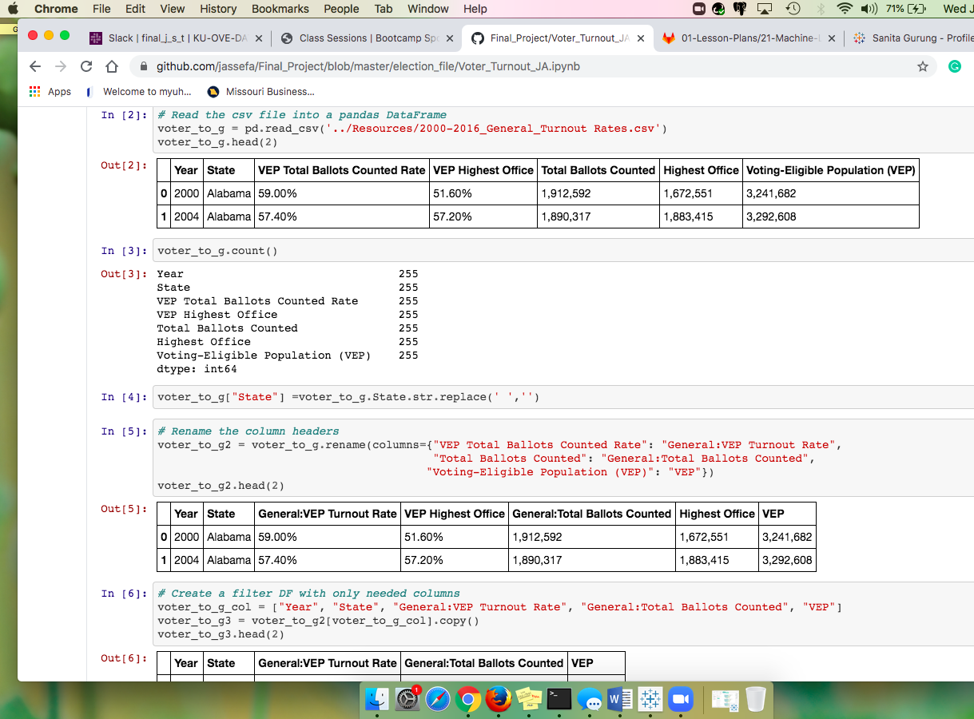

Data Cleaning
Imported 2000-2016 General Election turnout rate and counted the number of rows to insure 255 rows.
Had some spacing issues with key data, where spaces were present after words and making it difficult to refer to specific columns. For this reason, we removed any blank spaces in key words (i.e.. Rhode Island, New Hampshire, etc.).
Renamed columns and filtered out unneeded columns
Read in Primary Election Turnout data from CSV file and followed above cleaning process.
Read in Registered Voter by State data from CSV file and followed above cleaning process.
Jupyter Notebook

Slide 6
Data Cleaning
Jupyter Notebook
Merged data with a two step process. First, we merged General Election Turnout data with Registered Voter by State data using Left merge on “Year” and “State” because the Registered data had the most data, and General election had the 2nd highest amount of data. We checked rows and columns to make sure we did not lose anything.
Initially we lost some rows due to missing state values in Primary data that was missed during initial clean up process. We were missing Total Turnout Rate, Voter Eligible Population. We decided removing the data could affect our machine learning results, so filled blank state turnout rate columns with an average of valid turnout numbers from years for the same state. We also filled in VEP numbers based on VEP from general election.
Second and final merge was done with Primary Election Results data.
We checked data by counting number of rows and columns and looked for null values.
Once we saw all data was appearing as it should, we exported the data frame into CSV file Voter Final Clean Data.

Slide 7
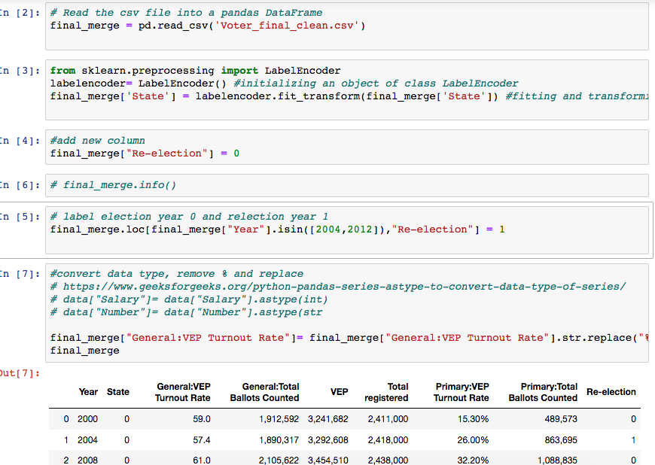
Further Data Cleaning for ML model
Jupyter Notebook: Import Voter Final Clean Data
Further cleaning was required to fit data into ML model such as removing “%” and “,” symbols as well as converting data type into float or int.
Imported from sklearn.preprocessing import LabelEncoder in order to label code states column
We wanted to see if voter turnout was impacted by new election year vs re-election year, so we added a new column called “Re-election” that tracked whether a specific election year was re-election or not.

Slide 8

Pandas Profiling generates profile reports from a pandas DataFrame.
The pandas df.describe() function is great but a little basic for serious exploratory data analysis. pandas profiling extends the pandas DataFrame with df.profile report() for quick data analysis.
For each column the following statistics are presented in an interactive HTML report:
Type inference: detect the types of columns in a data frame.
Essentials: type, unique values, missing values
Quantile statistics like minimum value, Q1, median, Q3, maximum, range, interquartile range
Descriptive statistics like mean, mode, standard deviation, sum, median absolute deviation, coefficient of variation, kurtosis, skewness
Most frequent values
Histogram
Correlations highlighting of highly correlated variables, Spearman, Pearson and Kendall matrices
Missing values matrix, count, heatmap and dendrogram of missing values
Text analysis learn about categories (Uppercase, Space), scripts (Latin, Cyrillic) and blocks (ASCII) of text data.
File and Image analysis extract file sizes, creation dates and dimensions and scan for truncated images or those containing EXIF information.

Slide 9
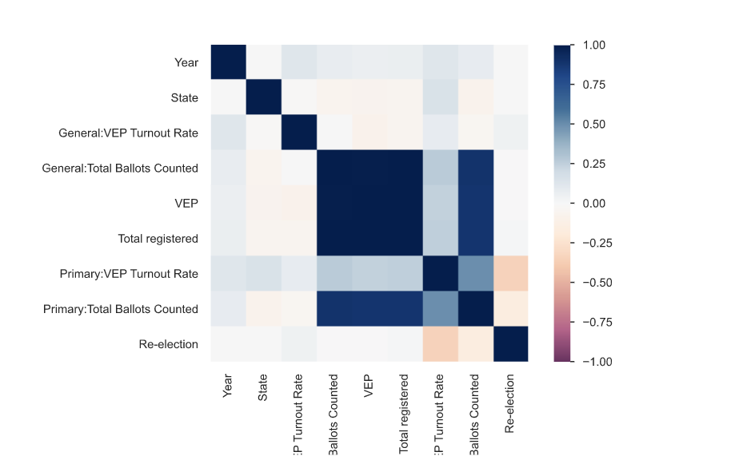
The Pearson's correlation coefficient (r) is a measure of linear correlation between two variables. It's value lies between -1 and +1, -1 indicating total negative linear correlation, 0 indicating no linear correlation and 1 indicating total positive linear correlation. Furthermore, r is invariant under separate changes in location and scale of the two variables, implying that for a linear function the angle to the x-axis does not affect r. To calculate r for two variables X and Y, one divides the covariance of X and Y by the product of their standard deviations.

Slide 10
MODEL Options
Initial examination of the SVM/SVR analysis Model looked like it would be a good fit as our pre-analysis showed some heavy outliers and SVR is supposed to be good for outlier understanding.
After initial attempts, it looked like this model would require too much time to understand and it was abandoned.
Another model examined was the HubbleRegression model. This model employed CrossValidation and Kfold scoring and is known for its lower bias than other methods.
This model appeared to have some good potential, and initially did provide additional information – it was hoped that we could compare this model’s output to that of the LinearRegression model.
However, after further review with the TA’s and better understanding of the data, we decided to stay with the LinearRegression model and run multiple variable sets and compare the results.
Ultimately, after running the ML LinearRegressions and using 2, 4 & 6 features (independent variables) of our Election data-set we discovered that with the max X variable predictor set we maximized both our R2 and MSE to give us the best results.

Slide 11





Our Approach
Linear regression models
Predict and Plot Residuals
Train and Test
Apply Features
Create Table
Repeat with different Features
Access

Slide 12

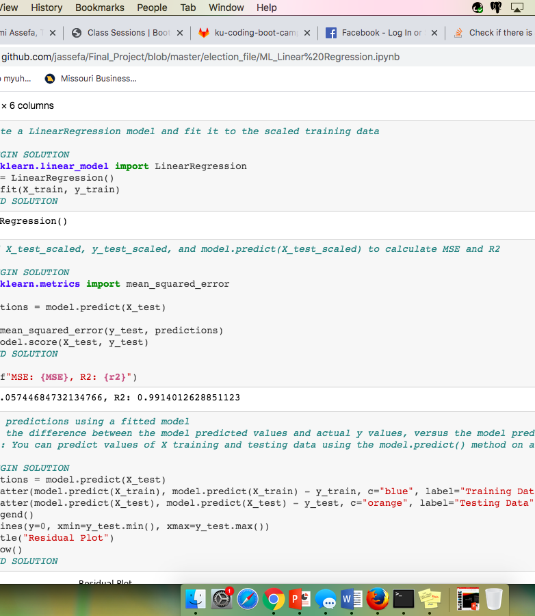
Preparing data for ML Model
We assigned X and y values, and reshaped y.
We Split the data into training and testing and imported from sklearn.preprocessing import StandardScaler to scale data for model.
We transformed the training and testing data using the X_scaler and y_scaler models to Normalize data.
We did not normalize year, state, and re-election values, since we were not looking into the numeric values themselves but looking to see if patterns existed with election year, state, or election type.
Because we did not want to normalize all x values, after scaling the columns we wanted, we reset x train and x test to scaled values. We are still unsure if this was the best approach.
After Creating a Linear Regression model and fitting it to the scaled training data, we used X_test_scaled, y_test_scaled, and model.predict(X_test_scaled) to calculate MSE and R2

Slide 13
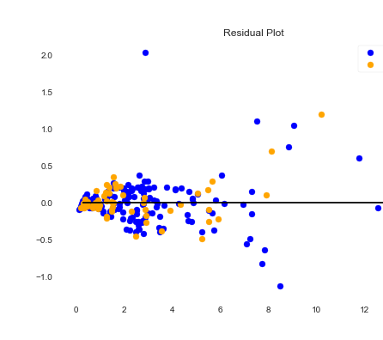
ML model 1 – Linear Regression Features: Election Year, State, Voter Eligible Population, Voters Registered, Primary Voter Turnout Count, Type of Election
MSE: 0.05744684732134782 R2: 0.9914012628851123
The MSE shows that our data values are dispersed closely to its mean, meaning low error rate and our R2 shows a high positive correlation.

Slide 14
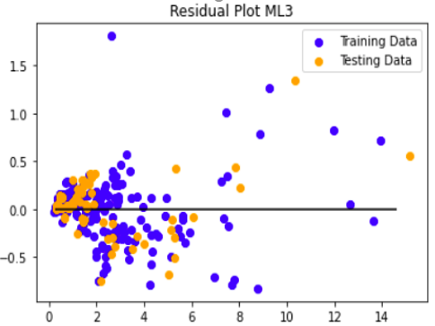
ML model 2– Linear Regression Features: Election Year, State, Voter Eligible Population, Primary Voter Turnout Count, General Turnout Count, Type of Election (Removed Registration)
MSE: 0.09559354853215604 R2: 0.9856914028874513
The MSE shows that our data values are dispersed midway between that of Model 1 and Model 2 relative to its mean, and our R2 shows a positive correlation midway between that of Model 1 and Model 2.

Slide 15
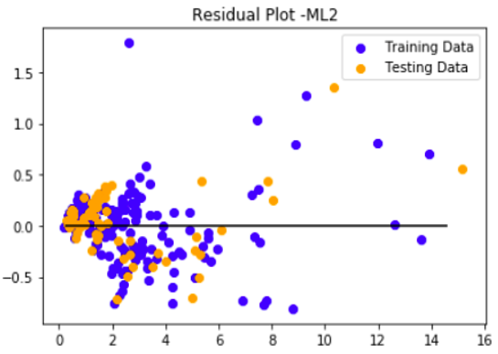
ML model 3– Linear Regression Features: Election Year, State, Voter Eligible Population, Primary Voter Turnout Count, General Turnout Count ( Removed Election Type & Registration)
MSE: 0.09766850927878988 R2: 0.9853808194034837
As we reduce the # of features, we see the error rate continue to increase and our R2 correlation decrease.

Slide 16

Tableau Visualization https://public.tableau.com/profile/jemi8235#!/vizhome/voterturnout_15936712018620/Story1?publish=yes

Slide 17
Conclusions
Relations, Correlations, Predictions
While our R2 indicated high correlation in all 3 models, we saw a notable increase in prediction error rate as we reduced the number of features.
Correlation is often interpreted as causation which is a big misconception. Correlation between variables does NOT indicate causation. Any highly correlated variable should be examined and thought of carefully. Correlations are very useful in many applications, especially when conducting regression analysis. However, it should not be mixed with causality and misinterpreted in any way. You should also always check the correlation between different variables in your dataset and gather some insights as part of your exploration and analysis.
We found General Election Voter Turnout was affected by the characteristics that we identified. However, Primary Turnout did not have the greatest impact, instead, Voter Registration had the greatest correlation with General Voter Turnout.
If we had more time, we would investigate the impact in Primary turnout based on Primary/Caucus, Open/Close Primary, and many other factors that can give us more insight.

